Slide 1


Game Engines 1
Dr Bryan Duggan
DIT School of Computing
bryan.duggan@dit.ie
@ditcomputing
http://facebook.com/ditschoolofcomputing

Slide 2
Questions we will answer today
What is Game Engines 1?
What is Games Engines 1 NOT?
What are the prerequisites?
What exactly will we DO?
What resources do I need?
What is the assignment?
What do I have to do to pass?

Slide 3
What is Games Engines 1
A foundation course in programming, maths and physics required to program 3D games
Consider…

Slide 4


Slide 5
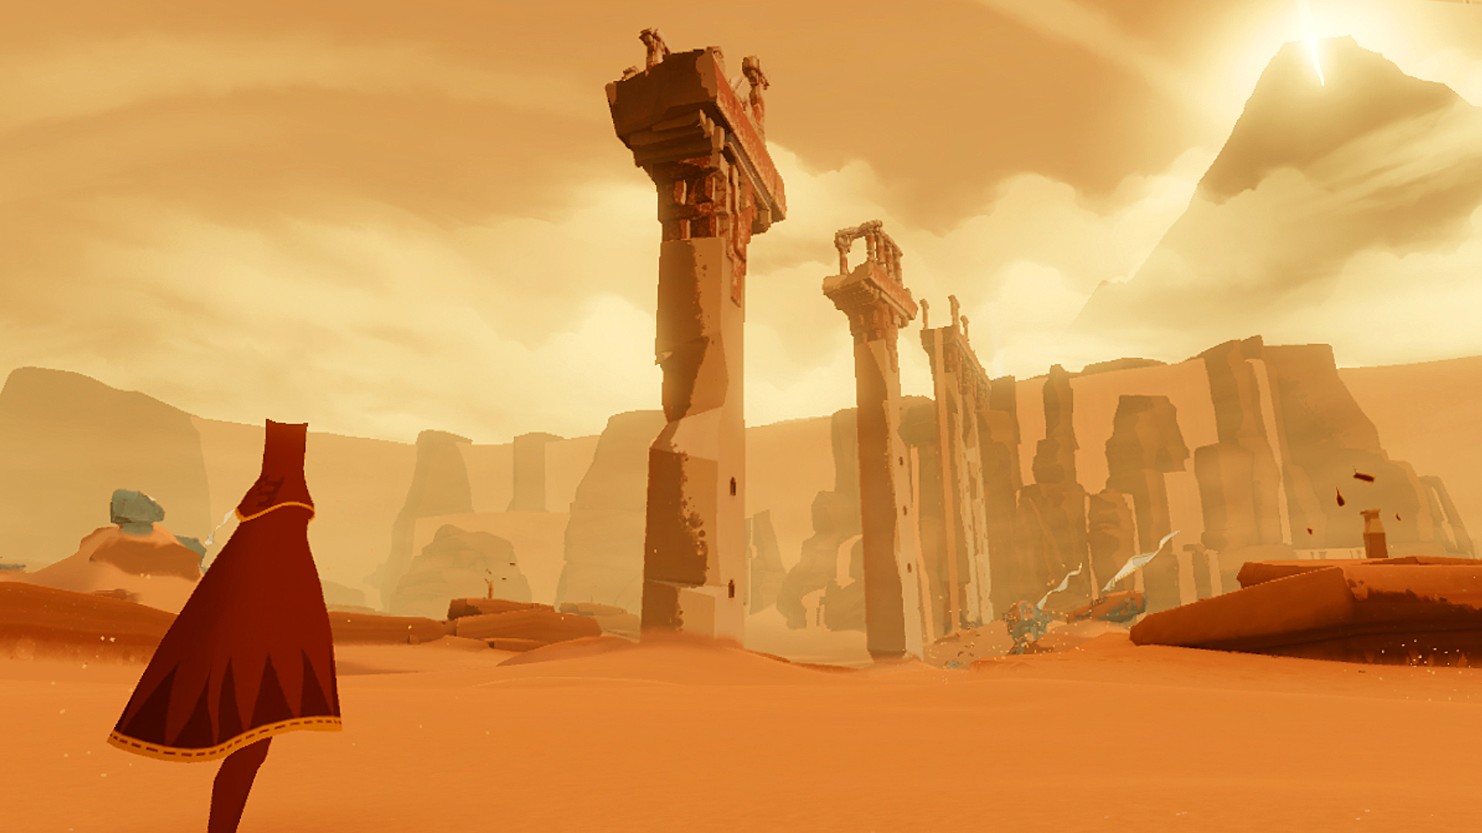

Slide 6
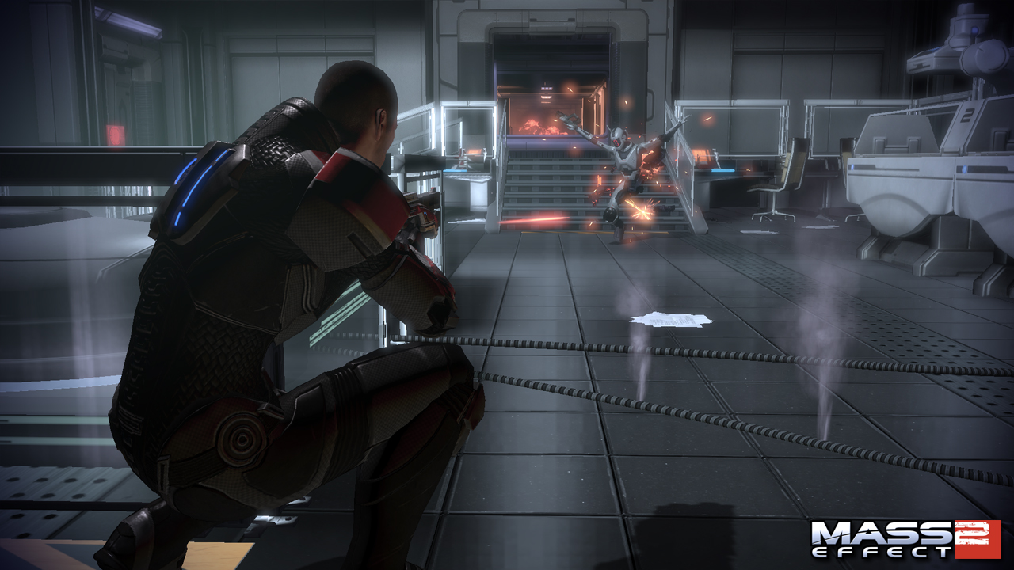

Slide 7
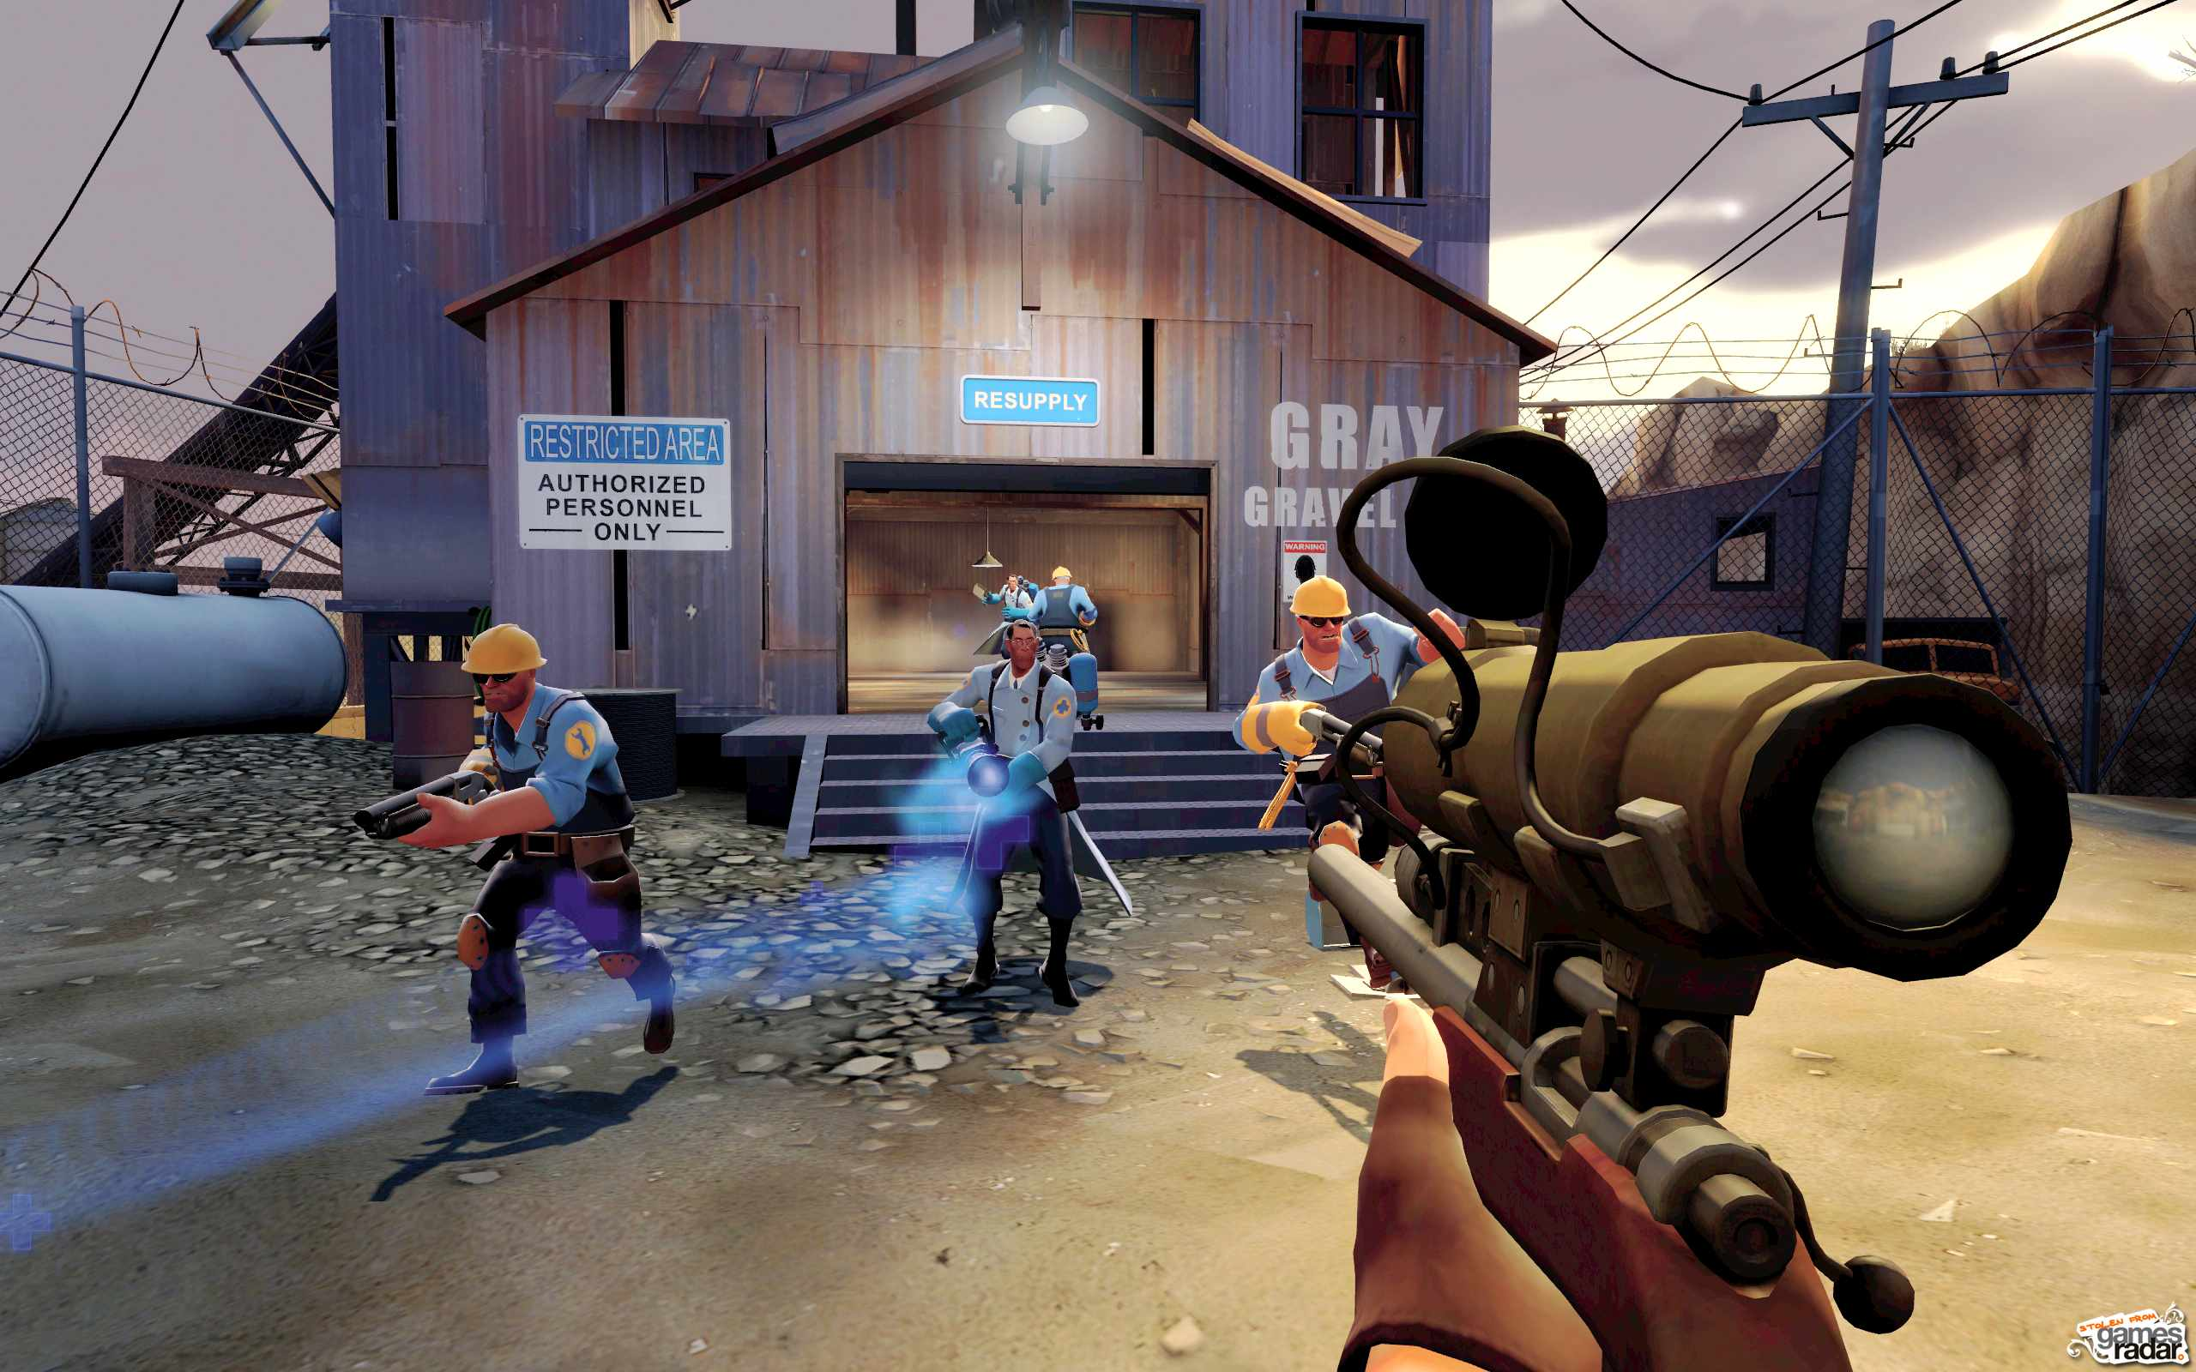

Slide 8
What do they have in common?
All programmed in C++ (with scripting)
3D rendering of textured objects
A scene graph
Particle effects
“Realistic” physics (rag dolls, collisions, explosions etc)
Character animation (we wont be doing this)
Character AI
We add:
Kinect skeletal tracking
Output to the Oculus Rift

Slide 9
What Games Engines is NOT
A C++/C# course
An XNA / MonoGame / Unity / Unreal / OpenGL / DirectX / <Insert technology here> course
Principles
Transferrable skills
Photoshop/Blender/3DS/Maya course
Its all about the CODE

Slide 10
The prerequisites
Fundamentals of OOP programming
No FEAR of CODE
No FEAR of MATHS
You shouldn’t be in 4th year if you have any of the above any as all 4th year subjects involve the above
Passion for technology
Passion for
Passion for games (you should at least know something about games)

Slide 11
In short
BAD
Fear, lazyness, lack of interest
Wanting to “just pass”
Asking questions like “How do I get a 1st”
GOOD
Passion, passion, passion
Curiosity
Creativity
Love of making cool things

Slide 12
So…what exactly will we be doing?
A refresher on C++
Objects, classes, inheritance, polymorphism
Containers, list, vector, map
Smart pointers and RTTI
Compiling and linking with 3rd party libraries
git
Maths for games
Coordinate geometry
Trigonometry
Vectors
Matrices
OpenGL Programming
Matrices & The rendering pipeline
VBO’s, vertices, colours
Basic shader programming
Texturing & lighting
Model loading

Slide 13
Physics for games
Position, time, mass, velocity, acceleration, gravity
Basic steering
Particle systems
Quaternions
3D physics
Programming a flight simulator
Use of a physics engine
Rigid bodies
Joints (constraints)
Gravity gun effects
Vehicles
Peripherals
Programming for Kinect
Programming for Oculus Rift

Slide 14
What resources do I need?
“Game Physics Engine Development: How to Build a Robust Commercial-Grade Physics Engine for your Game”
Visual Studio 2010/2012
git for Windows
Probably Windows. If you are on a mac/Linux
Eclipse

Slide 15

BGE

Slide 16
BGE
http://github.com/skooter500/BGE
OpenGL 3 with shaders
GLEW
GLM
SDL
OpenGL Context
Mouse & keyboard
SDL_TTF
Bullet Physics Engine
Kinect SDK
OVR

Slide 17
Semester 2 (Game Engines 2)
Steering behaviours
Seek, arrive, pursue, evade, offset pursuit
Wander, path following
Wall avoidance, sphere avoidance
Flocking
Finite State machines & behaviour trees
Path finding
Nav graph generation & representation
A*

Slide 18
Assignment
Make use of the technology you are learning on the course to hack together something magical
BGE/Monogame/Unity/Unreal
C++/C#
Kinect/Wii mote/PS Move
Ardwino & sensors
Oculus Rift
Leap Motion
Particle effects
Music
Speech recognition
Consider…

Slide 19
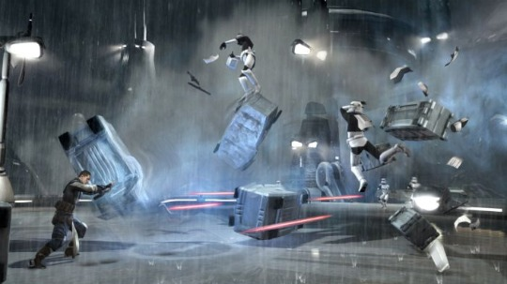

Slide 20


Slide 21


Slide 22



Slide 23


Slide 24


Slide 25


Slide 26


Slide 27


Slide 28


Slide 29
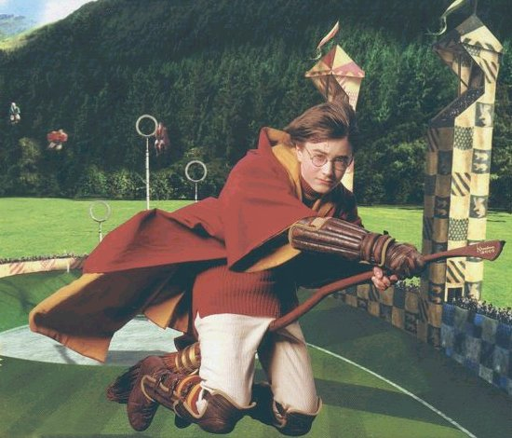

Slide 30


Slide 31


Slide 32


Slide 33


Slide 34


Slide 35
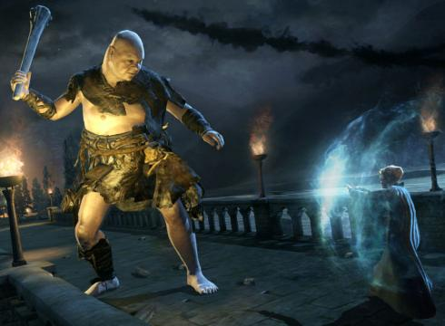

Slide 36


Slide 37


Slide 38


Slide 39
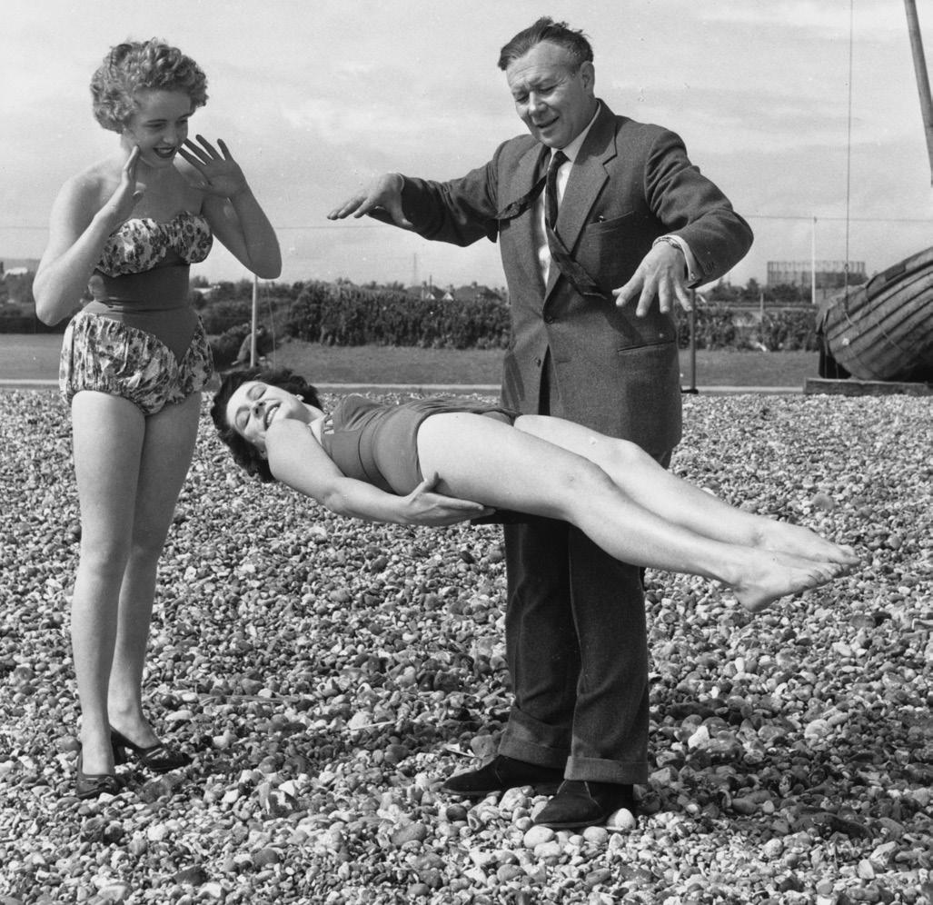

Slide 40


Slide 41
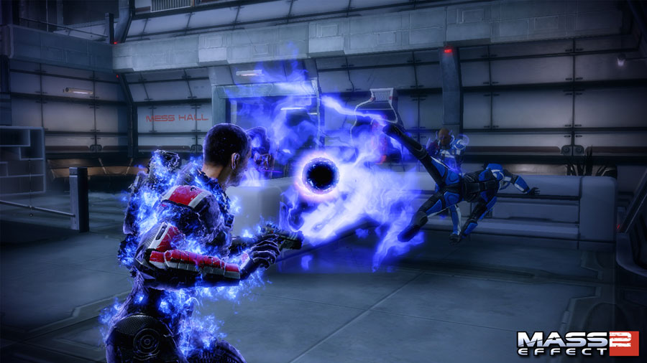

Slide 42


Slide 43


Slide 44
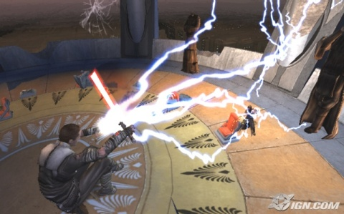

Slide 45


Slide 46


Slide 47


Slide 48


Slide 49


Slide 50


Slide 51


Slide 52

Special Quests!
Do something to improve BGE!
You must do a fork & pull request
Add LUA Scripting
Add scene management
Add support for Leap/Wii mote
Add skeletal animation
Really improve the particle system
Realistic positional audio with occlusion, reverb, doppler etc

Slide 53
Also any of the old assignment topics
Make a physics machine
Make a model of the Curiosity
Make a simulation of a robot arm
Control a robot using skeletal tracking
Make a game for a GameCraft/Games Fleadh
Dont’t let the assignment constrain your creativity (unless you want it to ☺)
Examples…
http://www.youtube.com/watch?v=5BPxM--x-7M
http://www.youtube.com/watch?v=5LgZOLrFFLQ

Slide 54
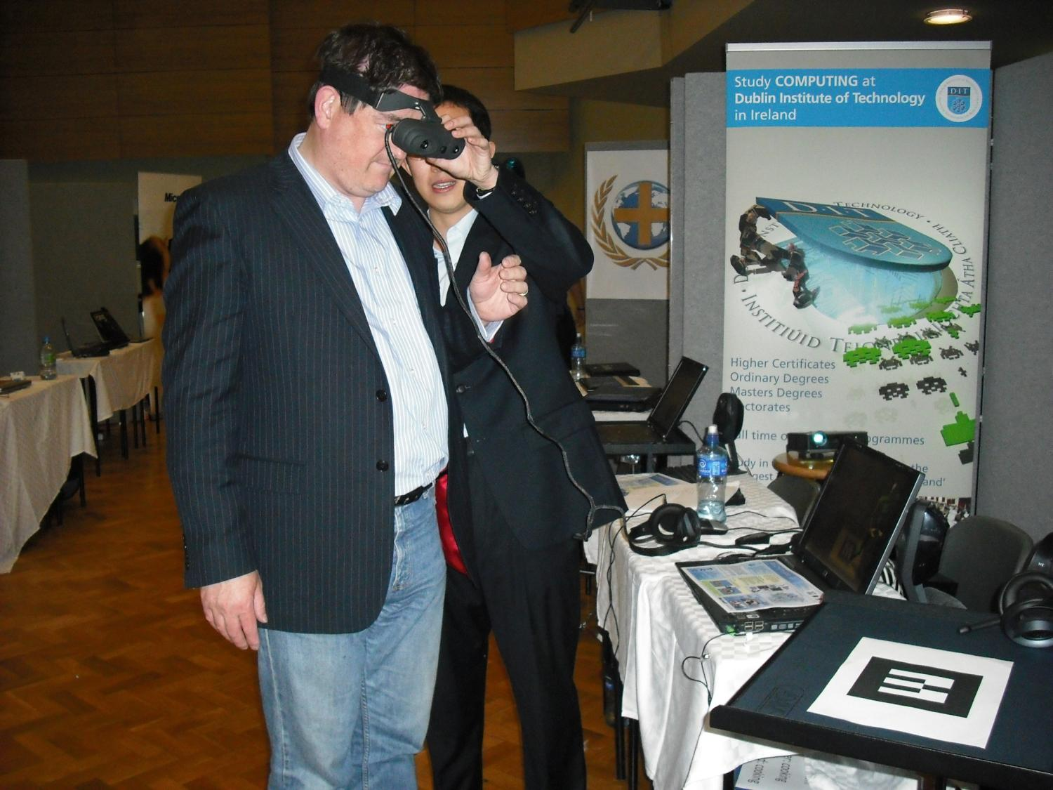

Slide 55
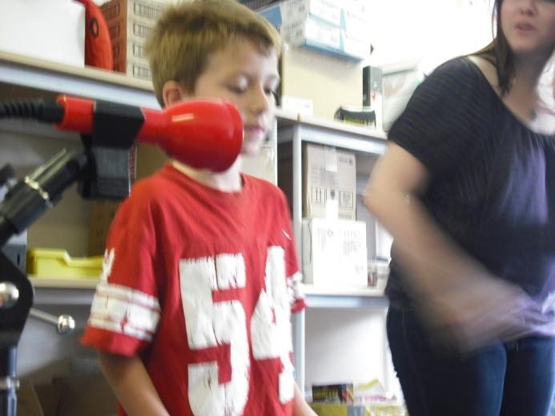
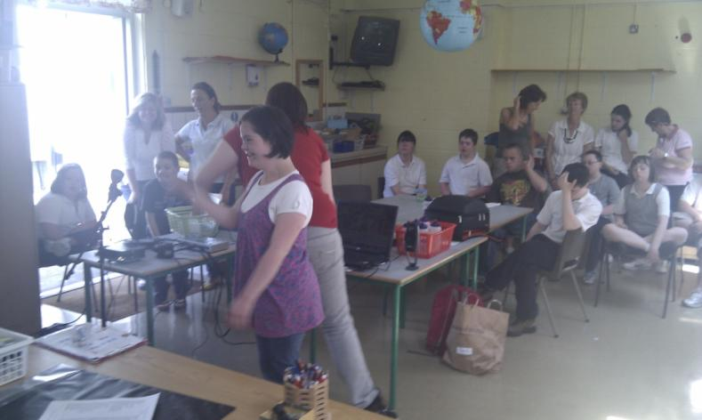



Slide 56
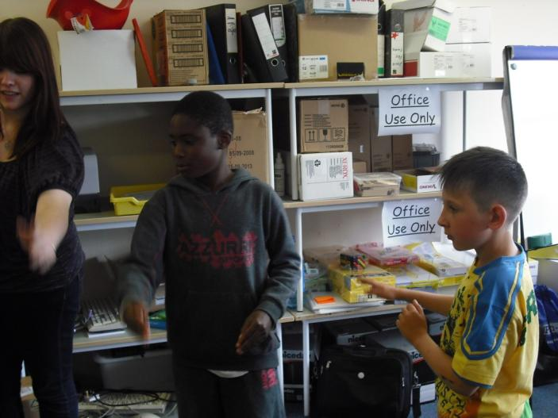
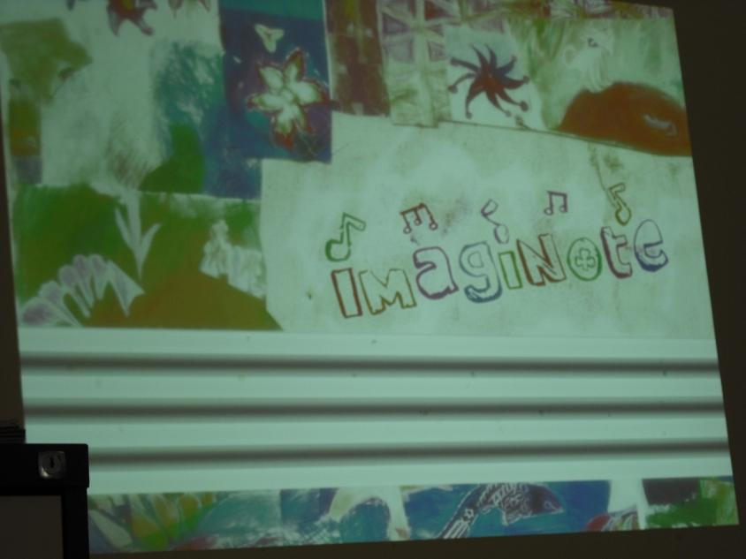
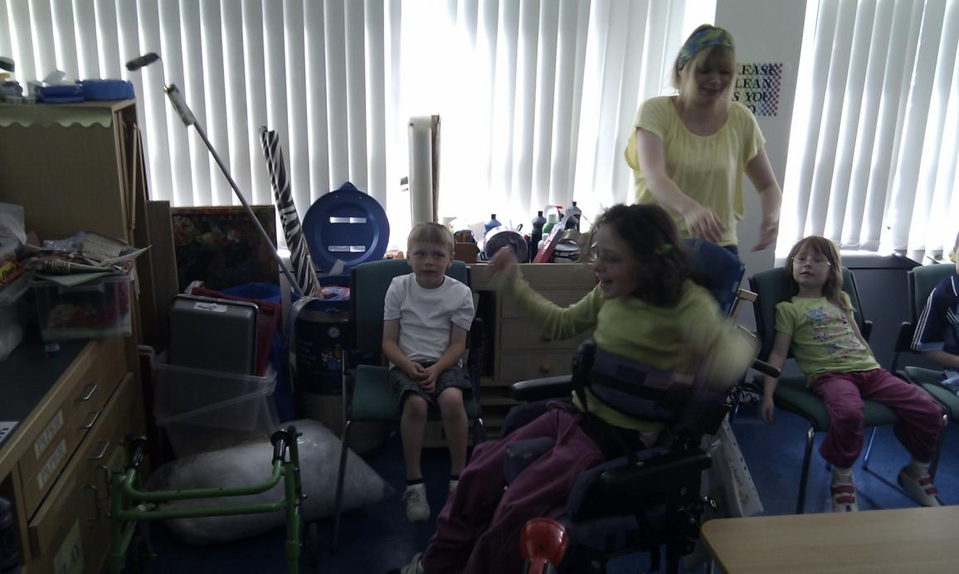
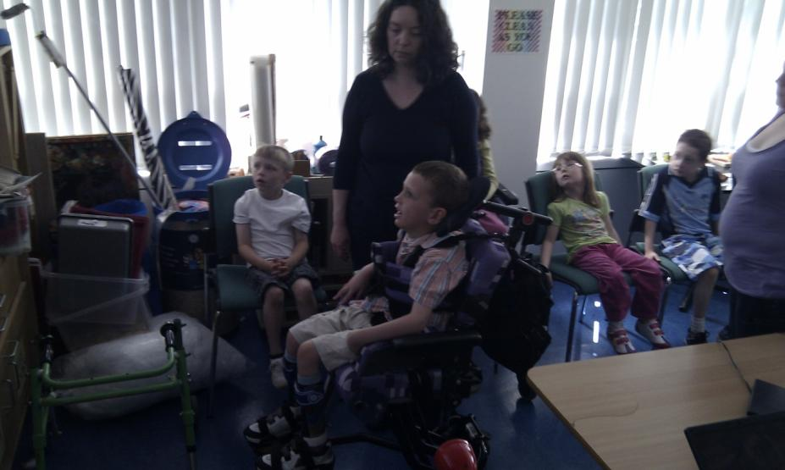

Slide 57
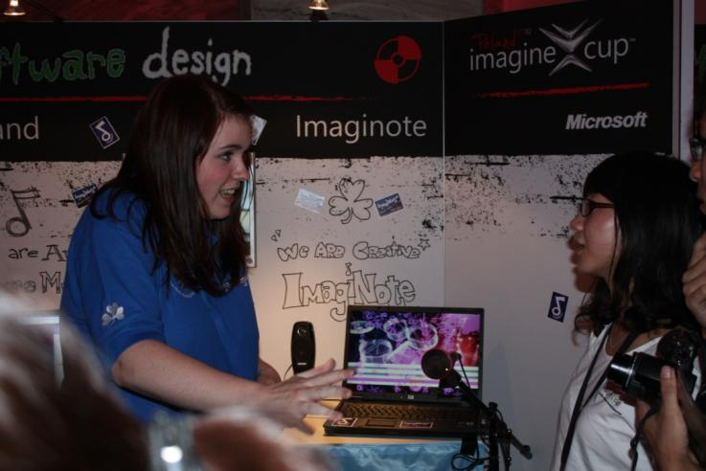
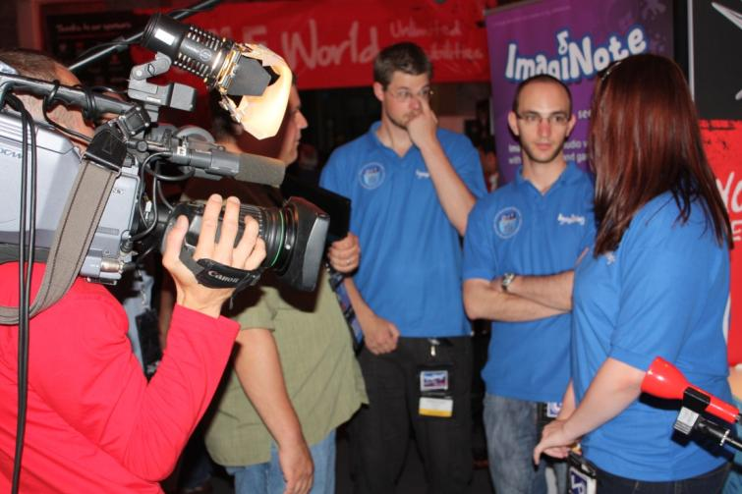


Slide 58
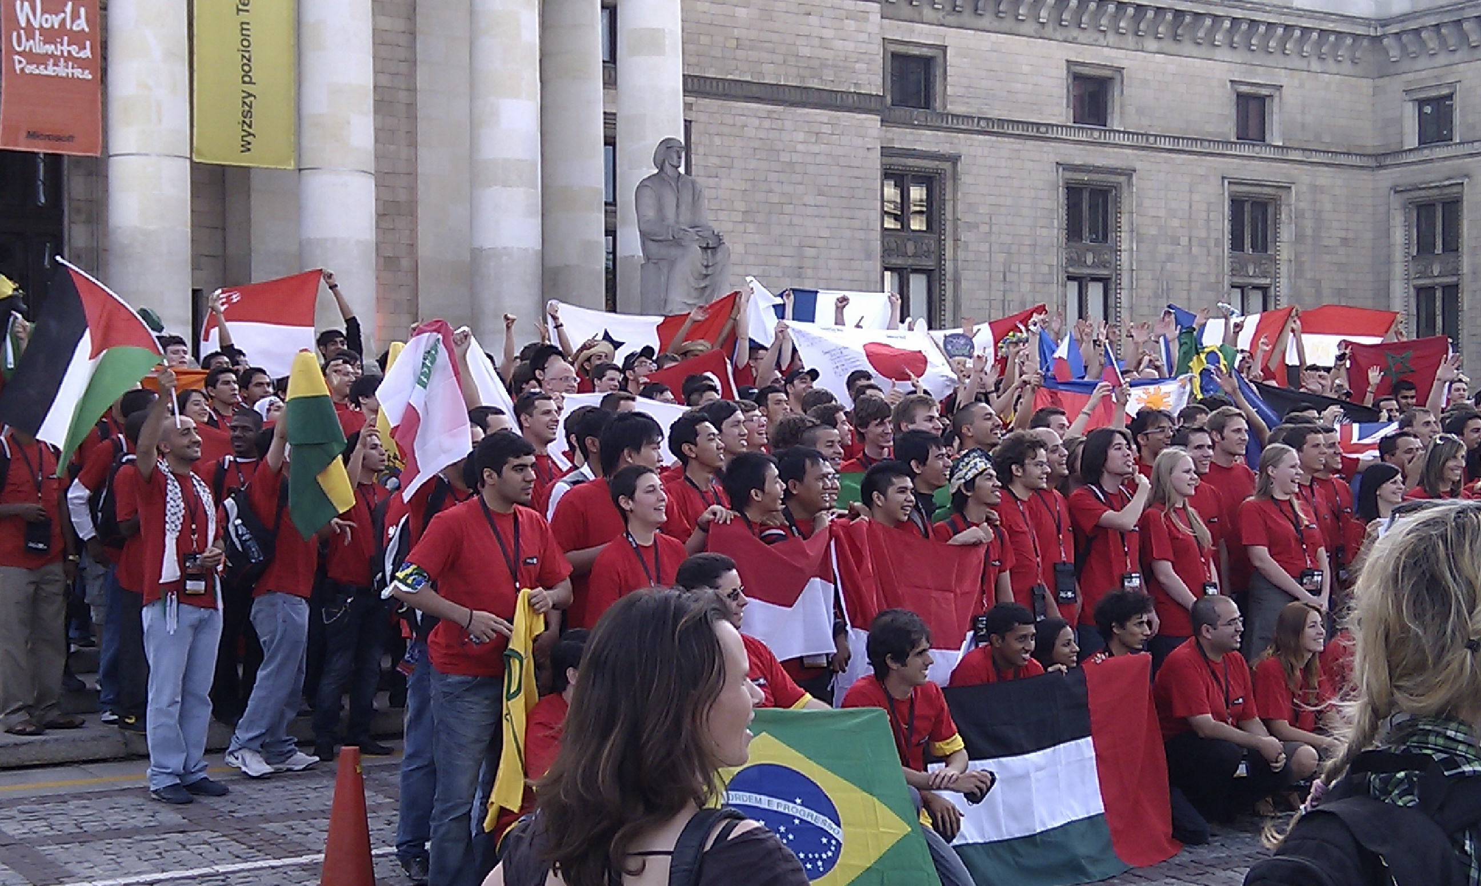

Slide 59



Slide 60
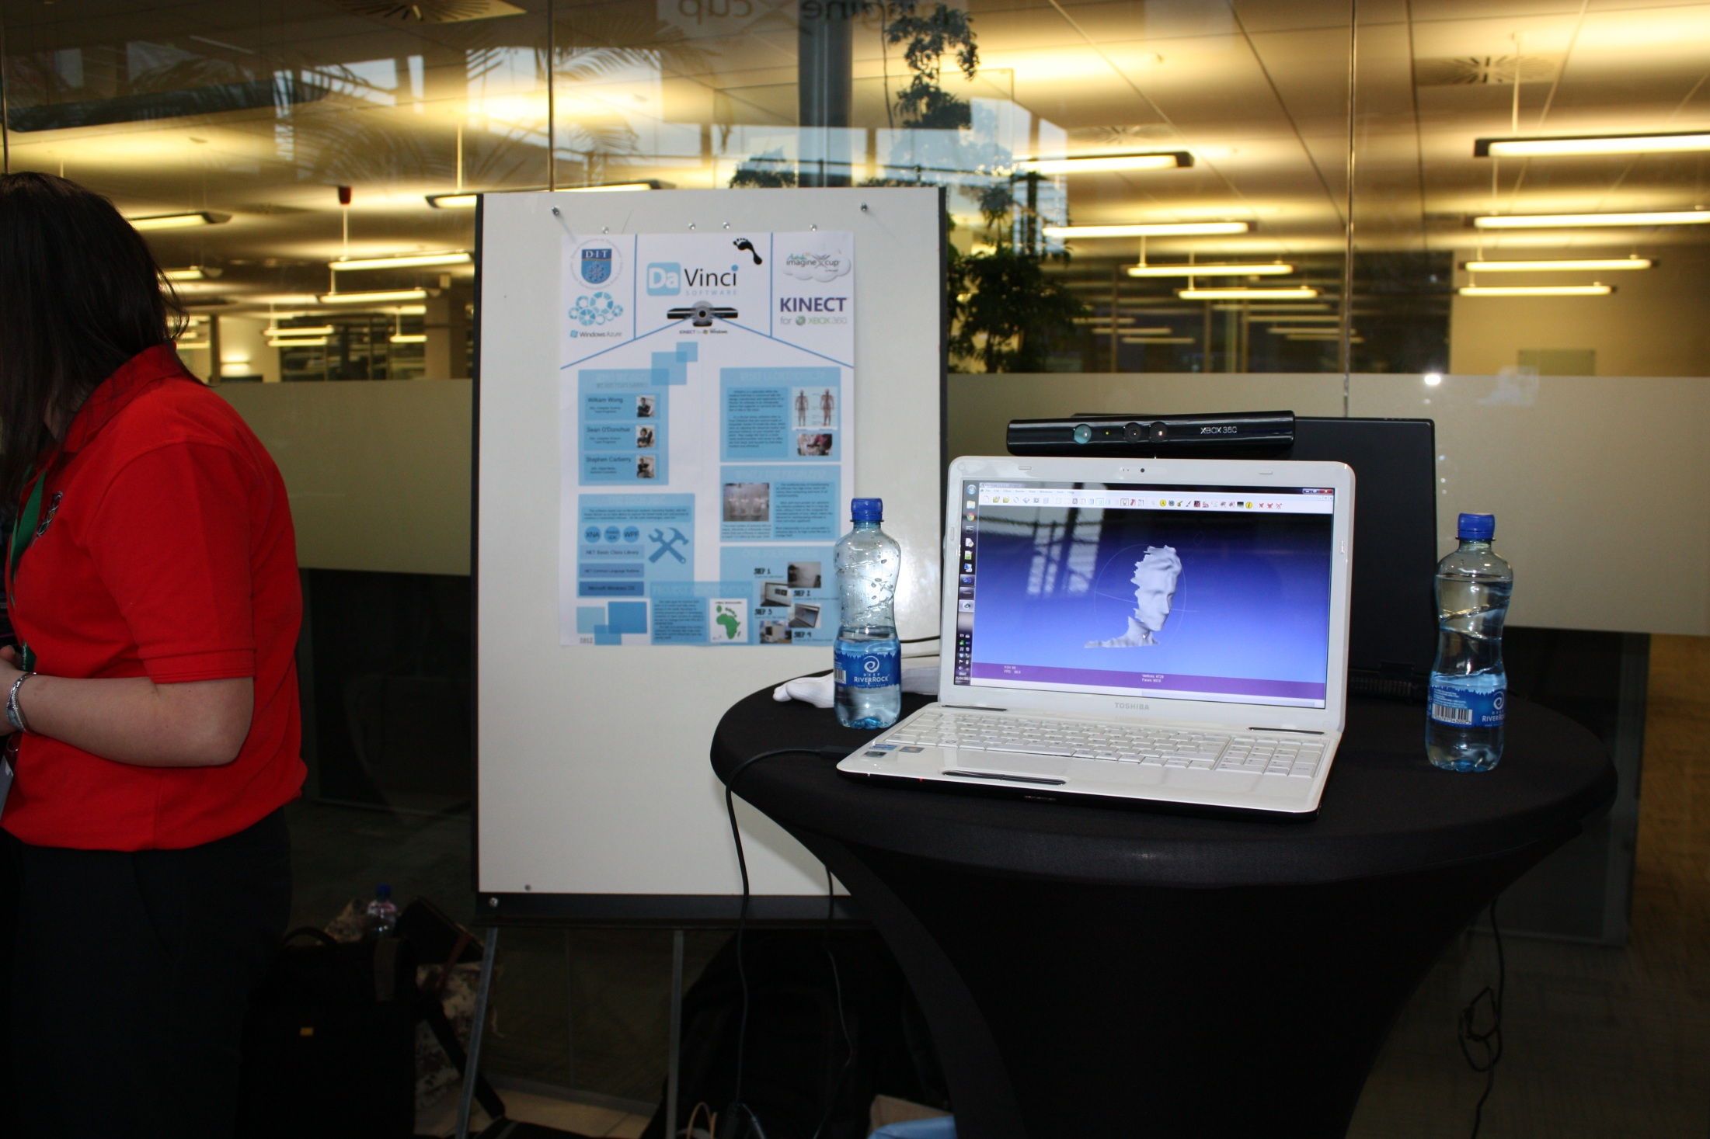

Slide 61
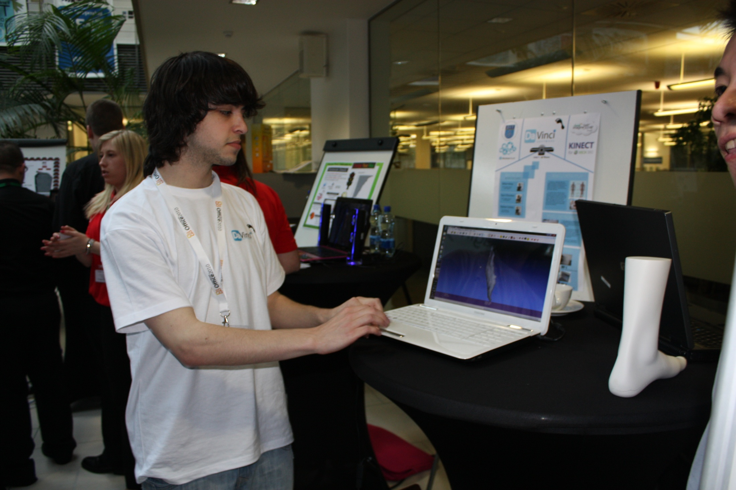

Slide 62
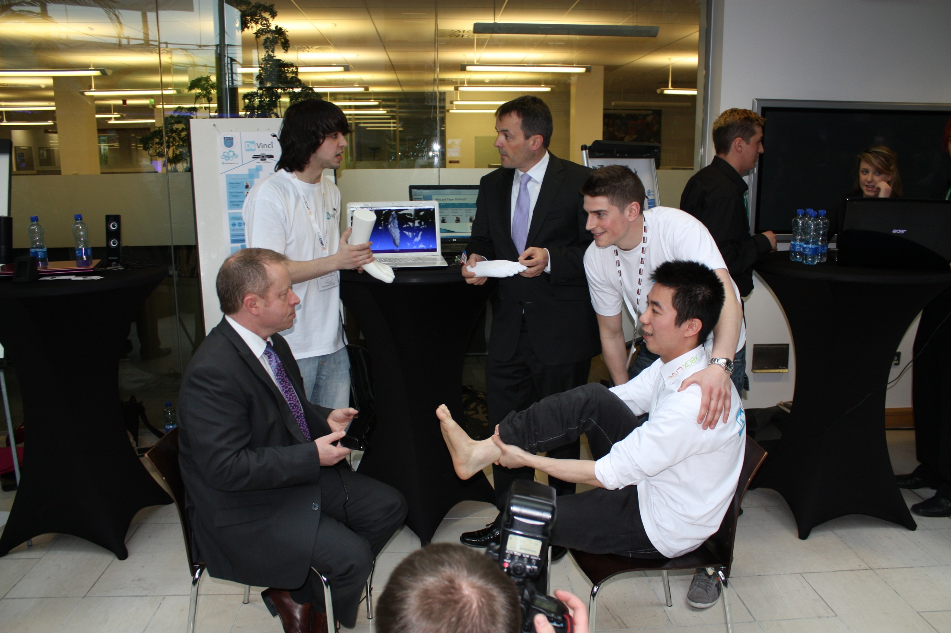

Slide 63
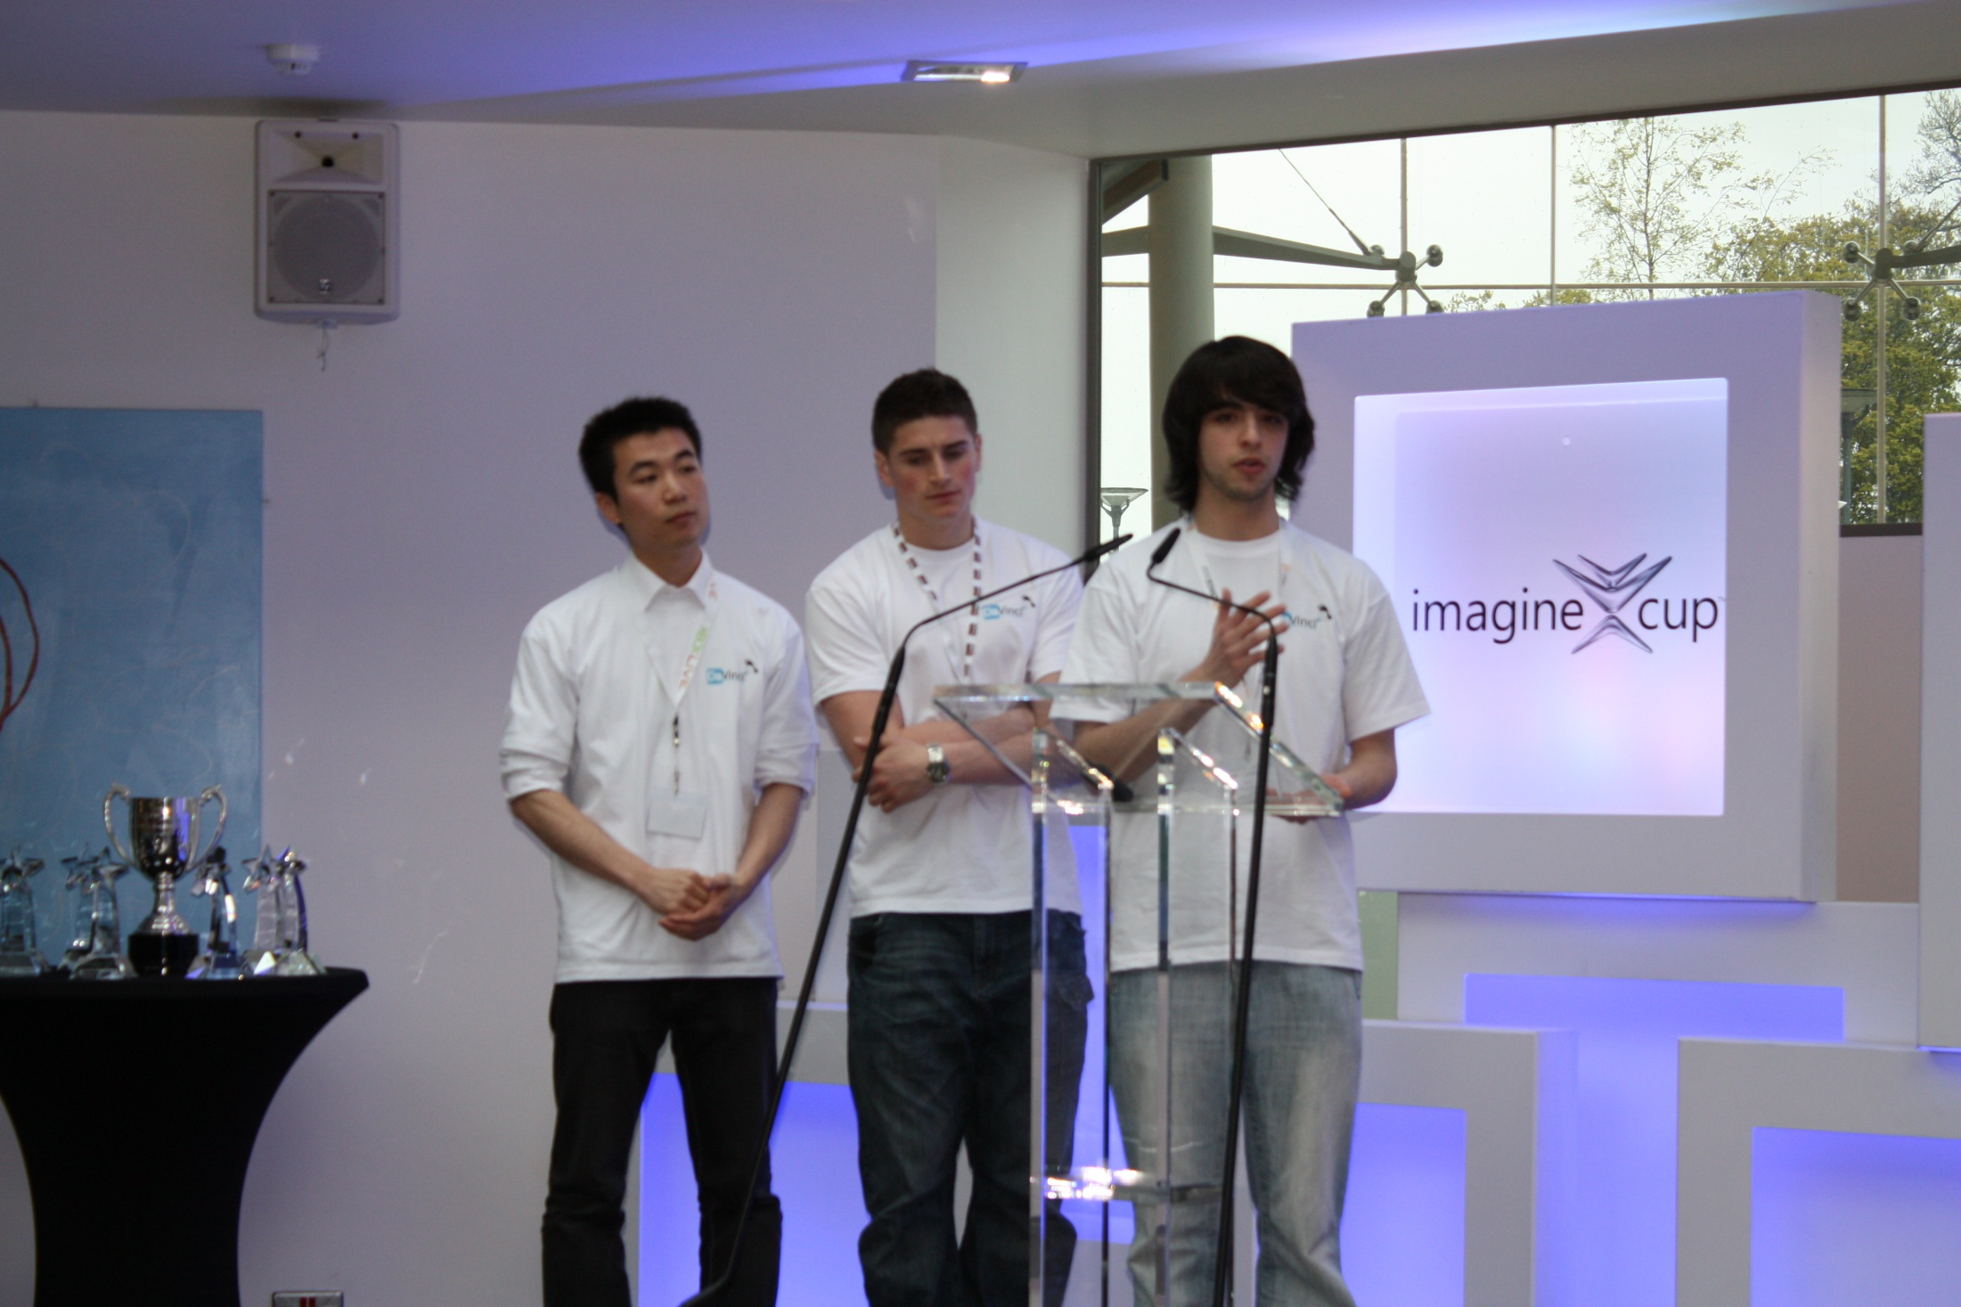

Slide 64
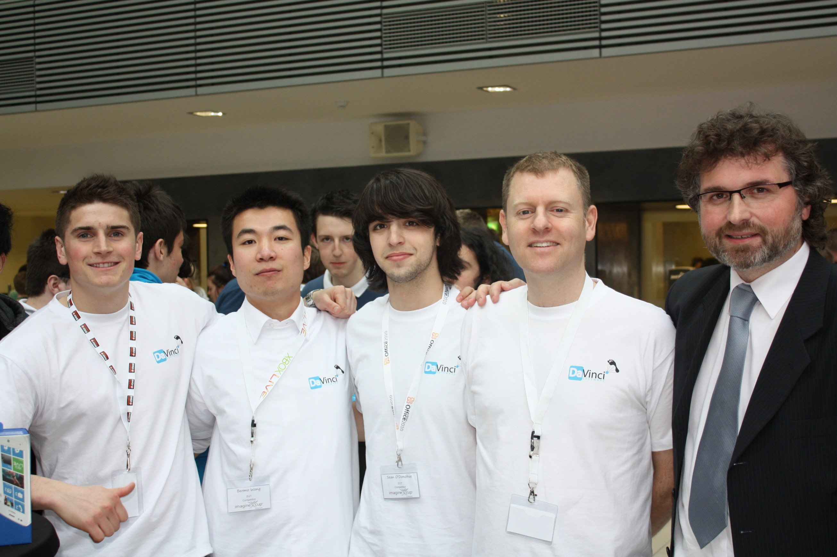

Slide 65
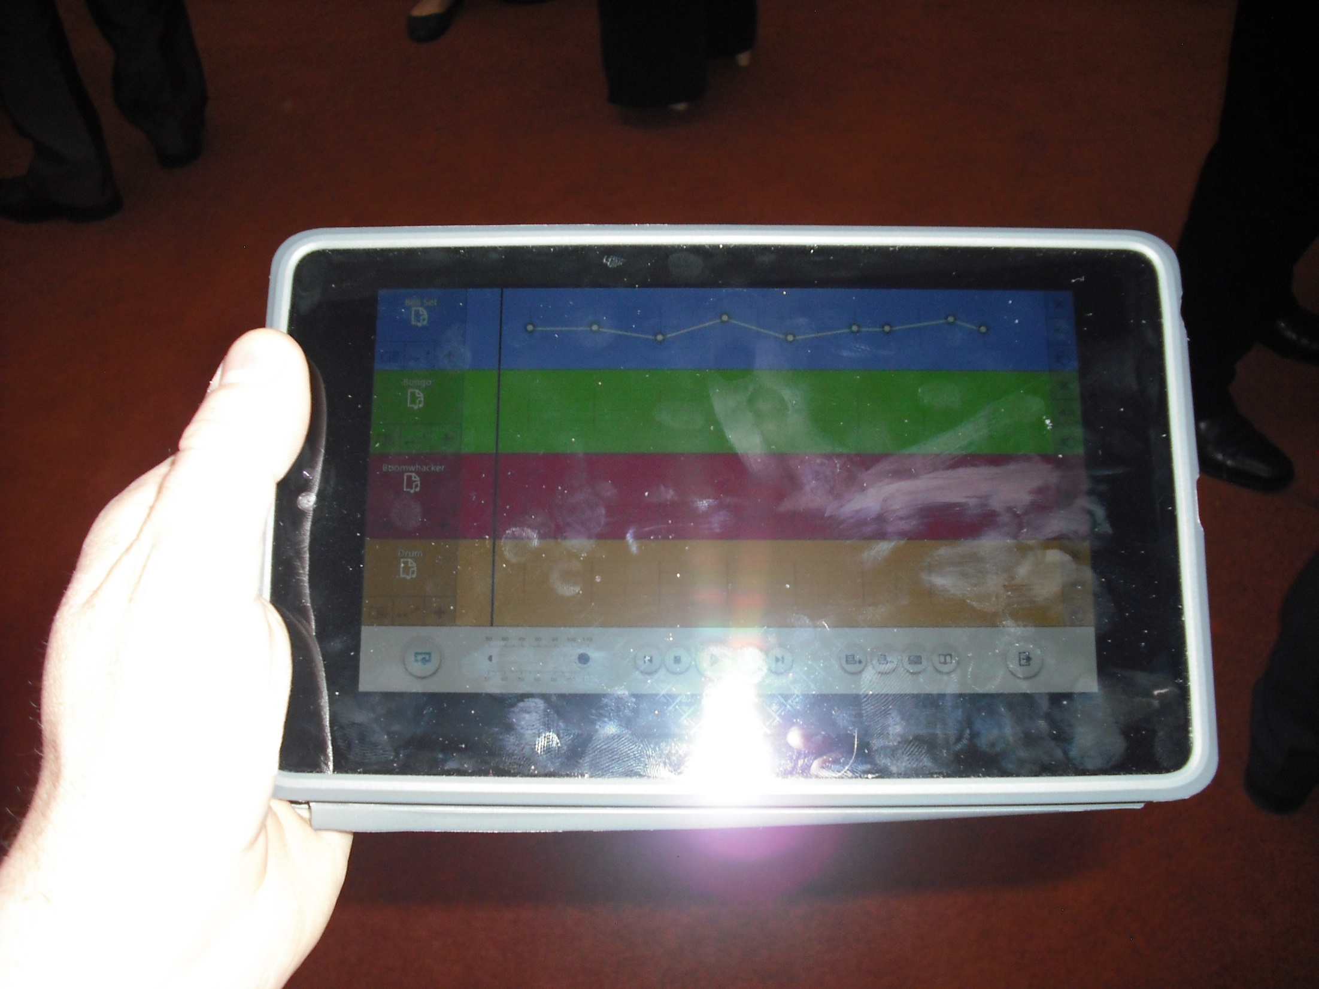

Slide 66
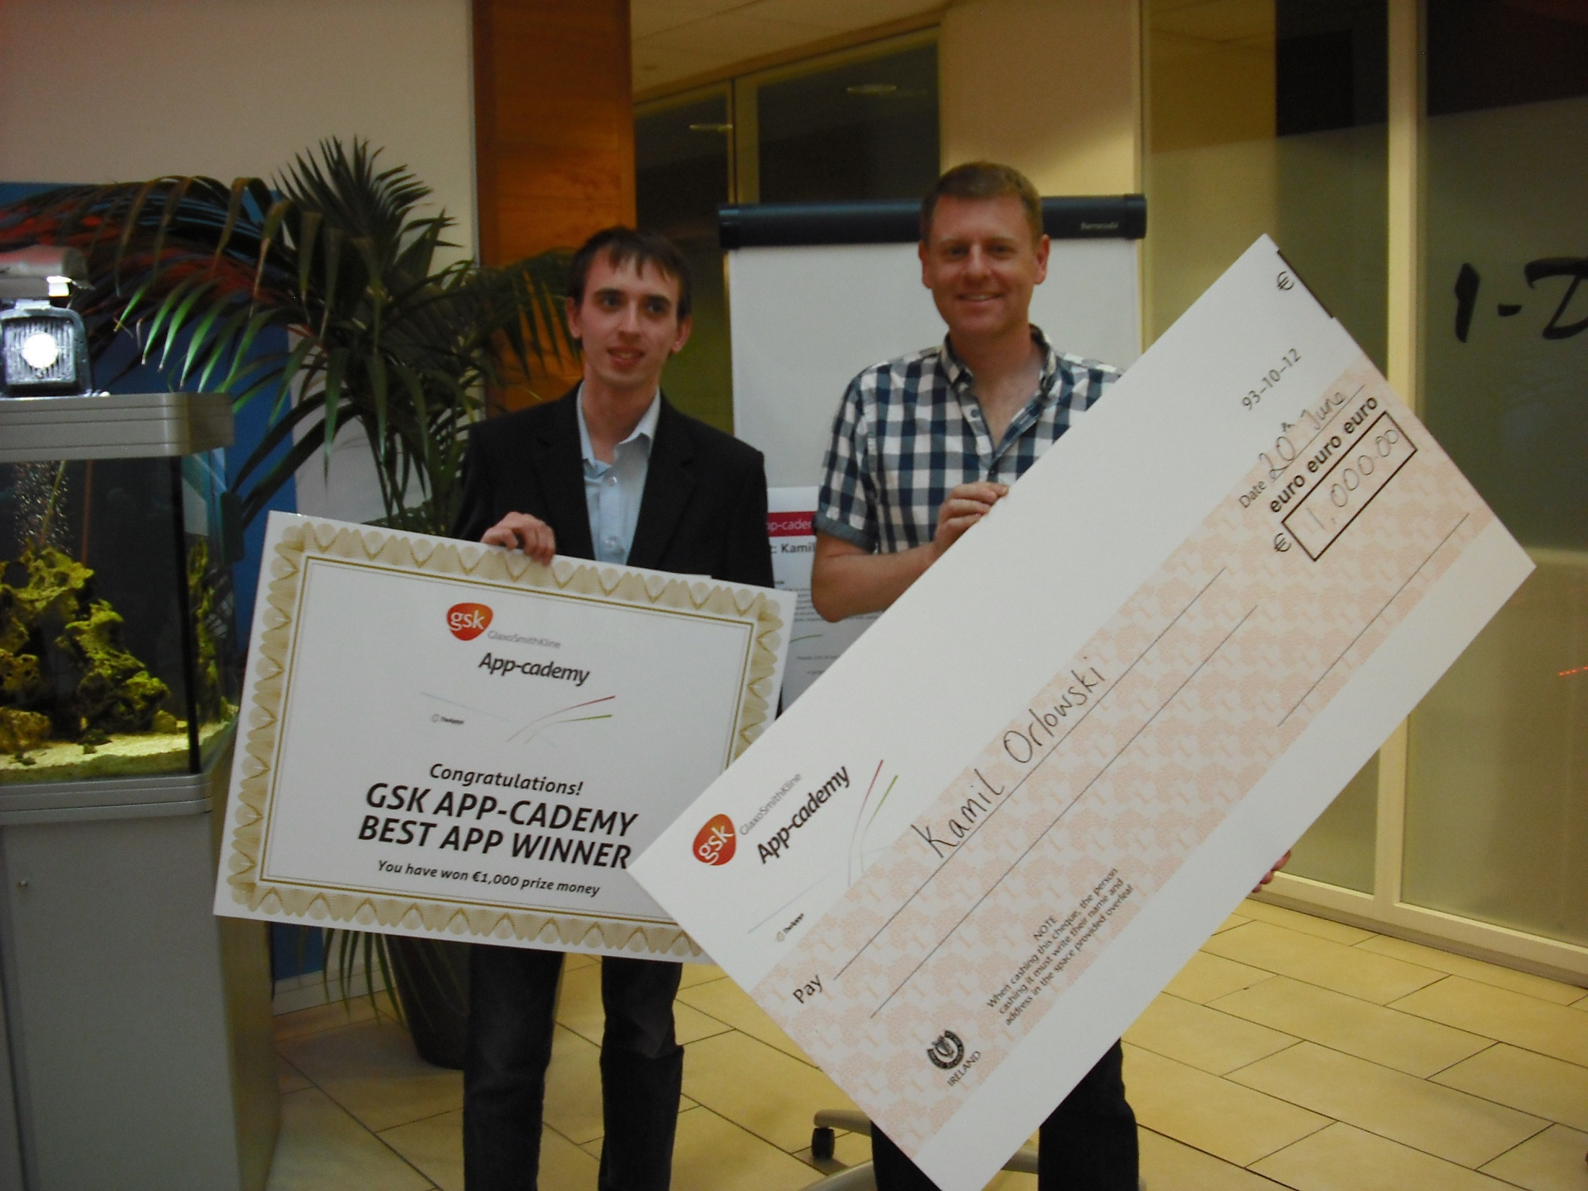

Slide 67
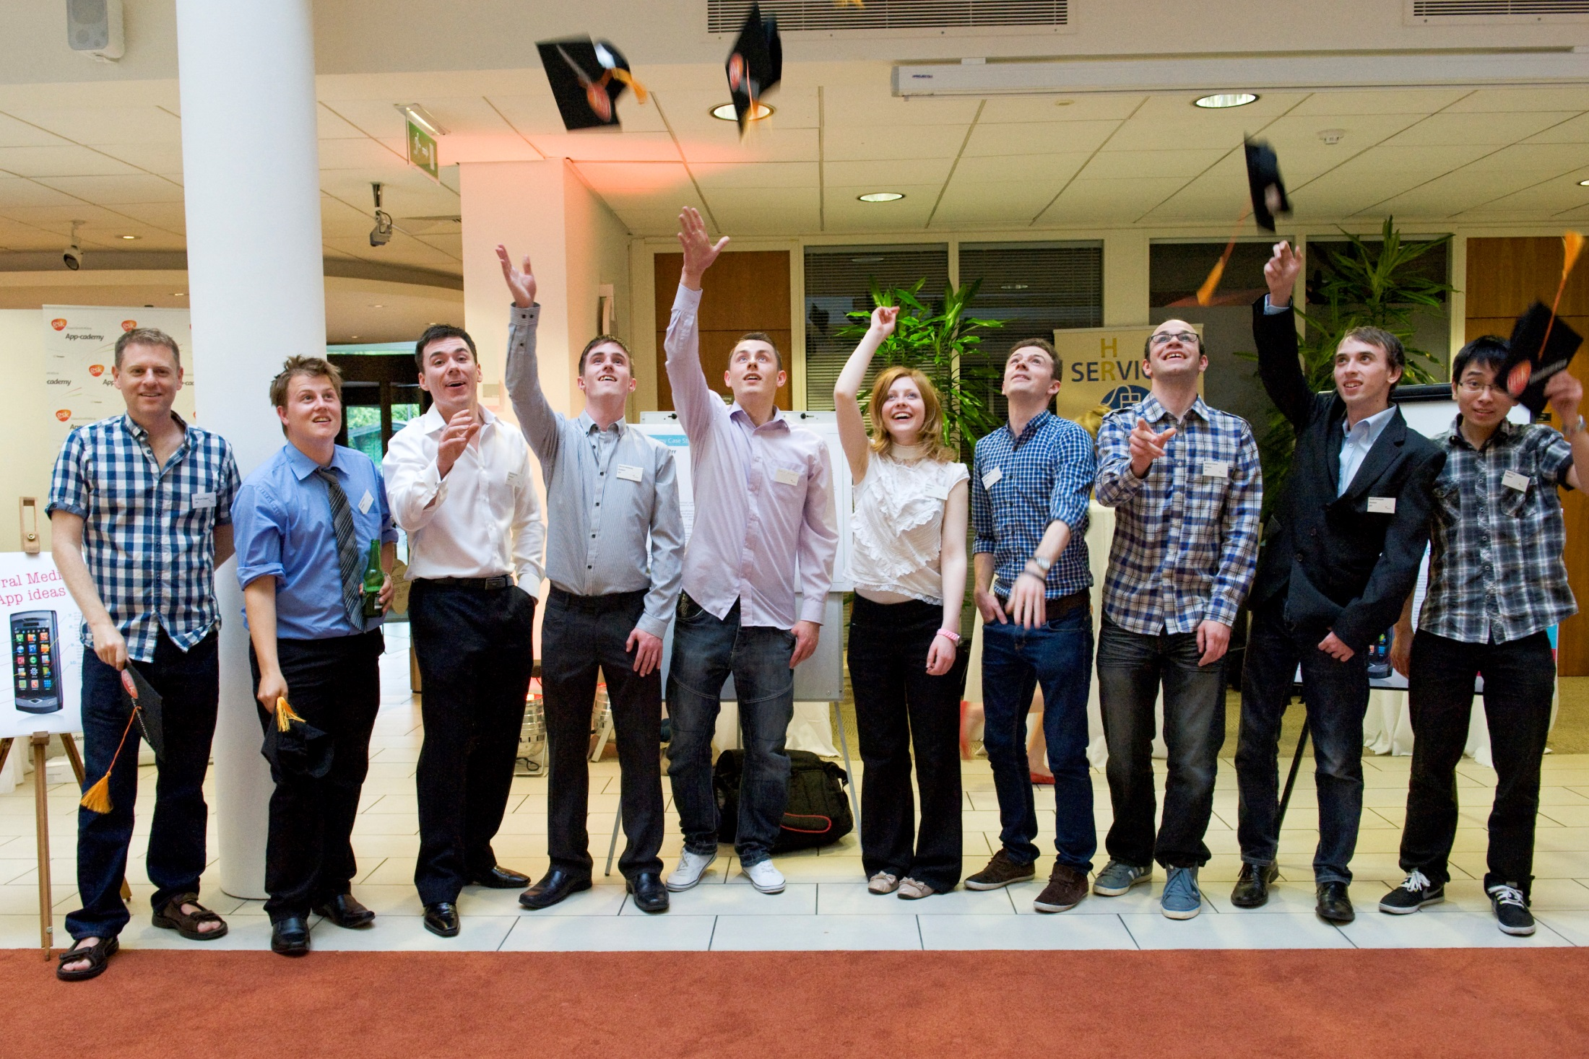

Slide 68
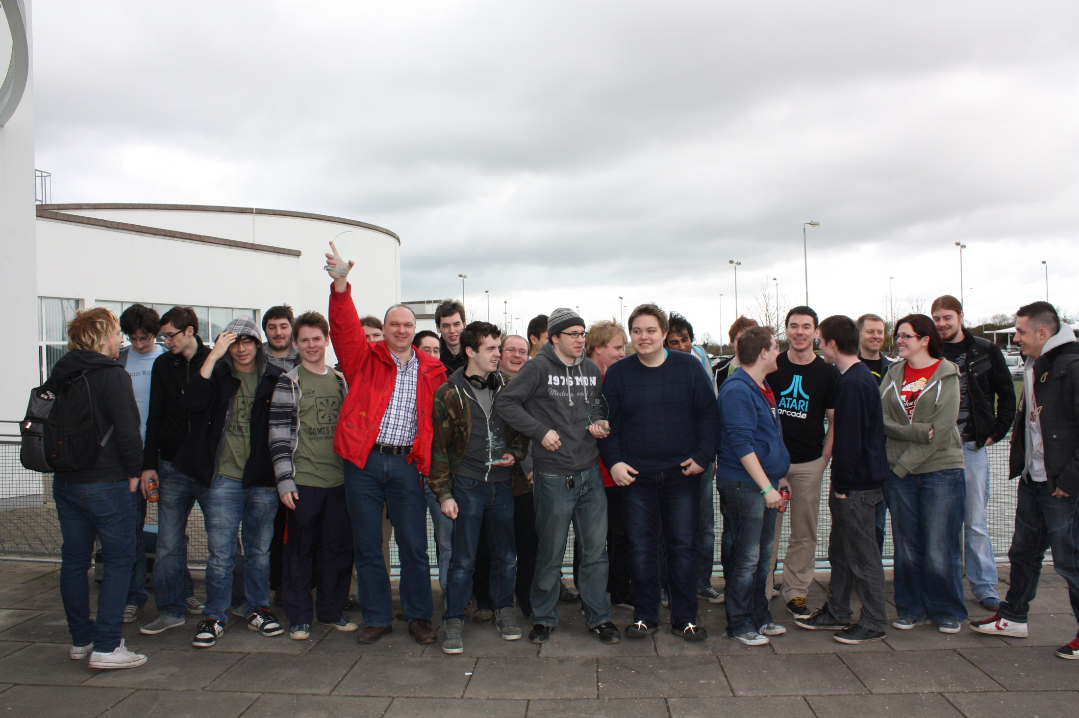

Slide 69
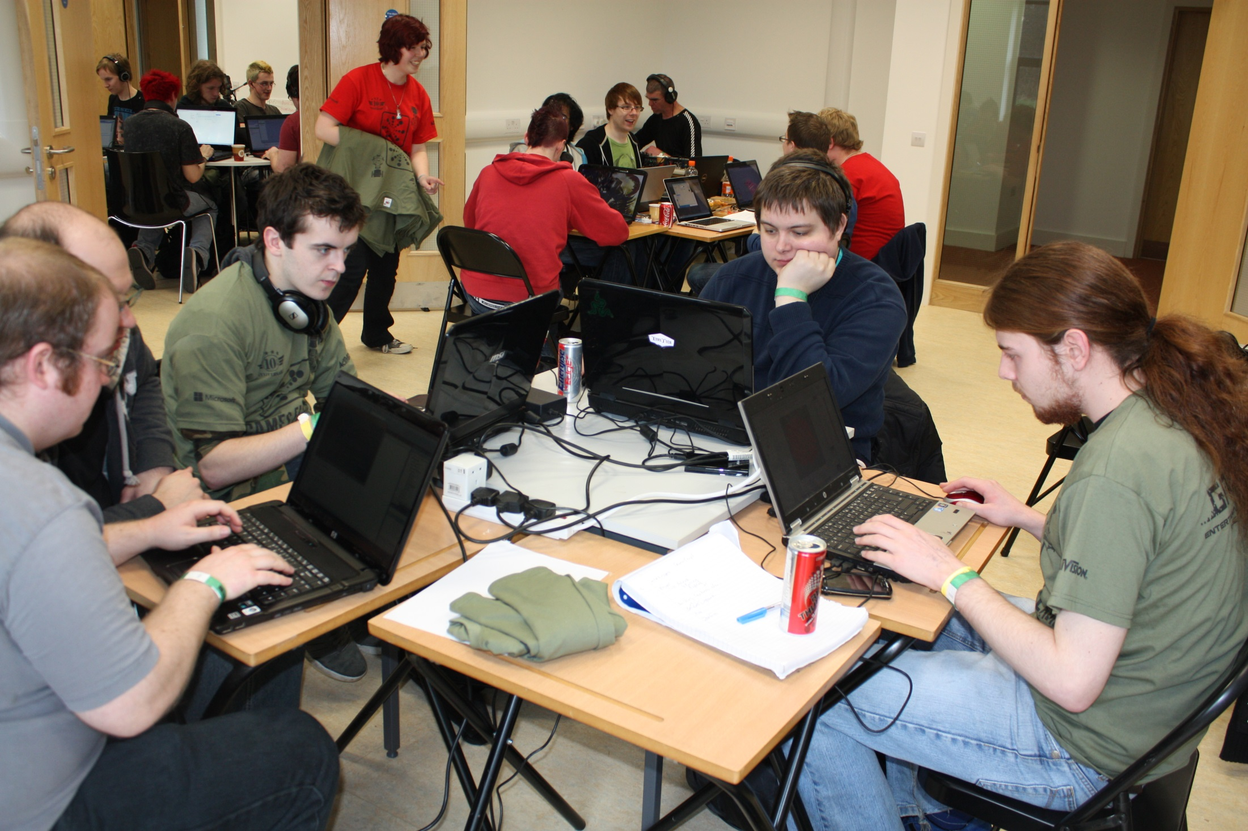

Slide 70
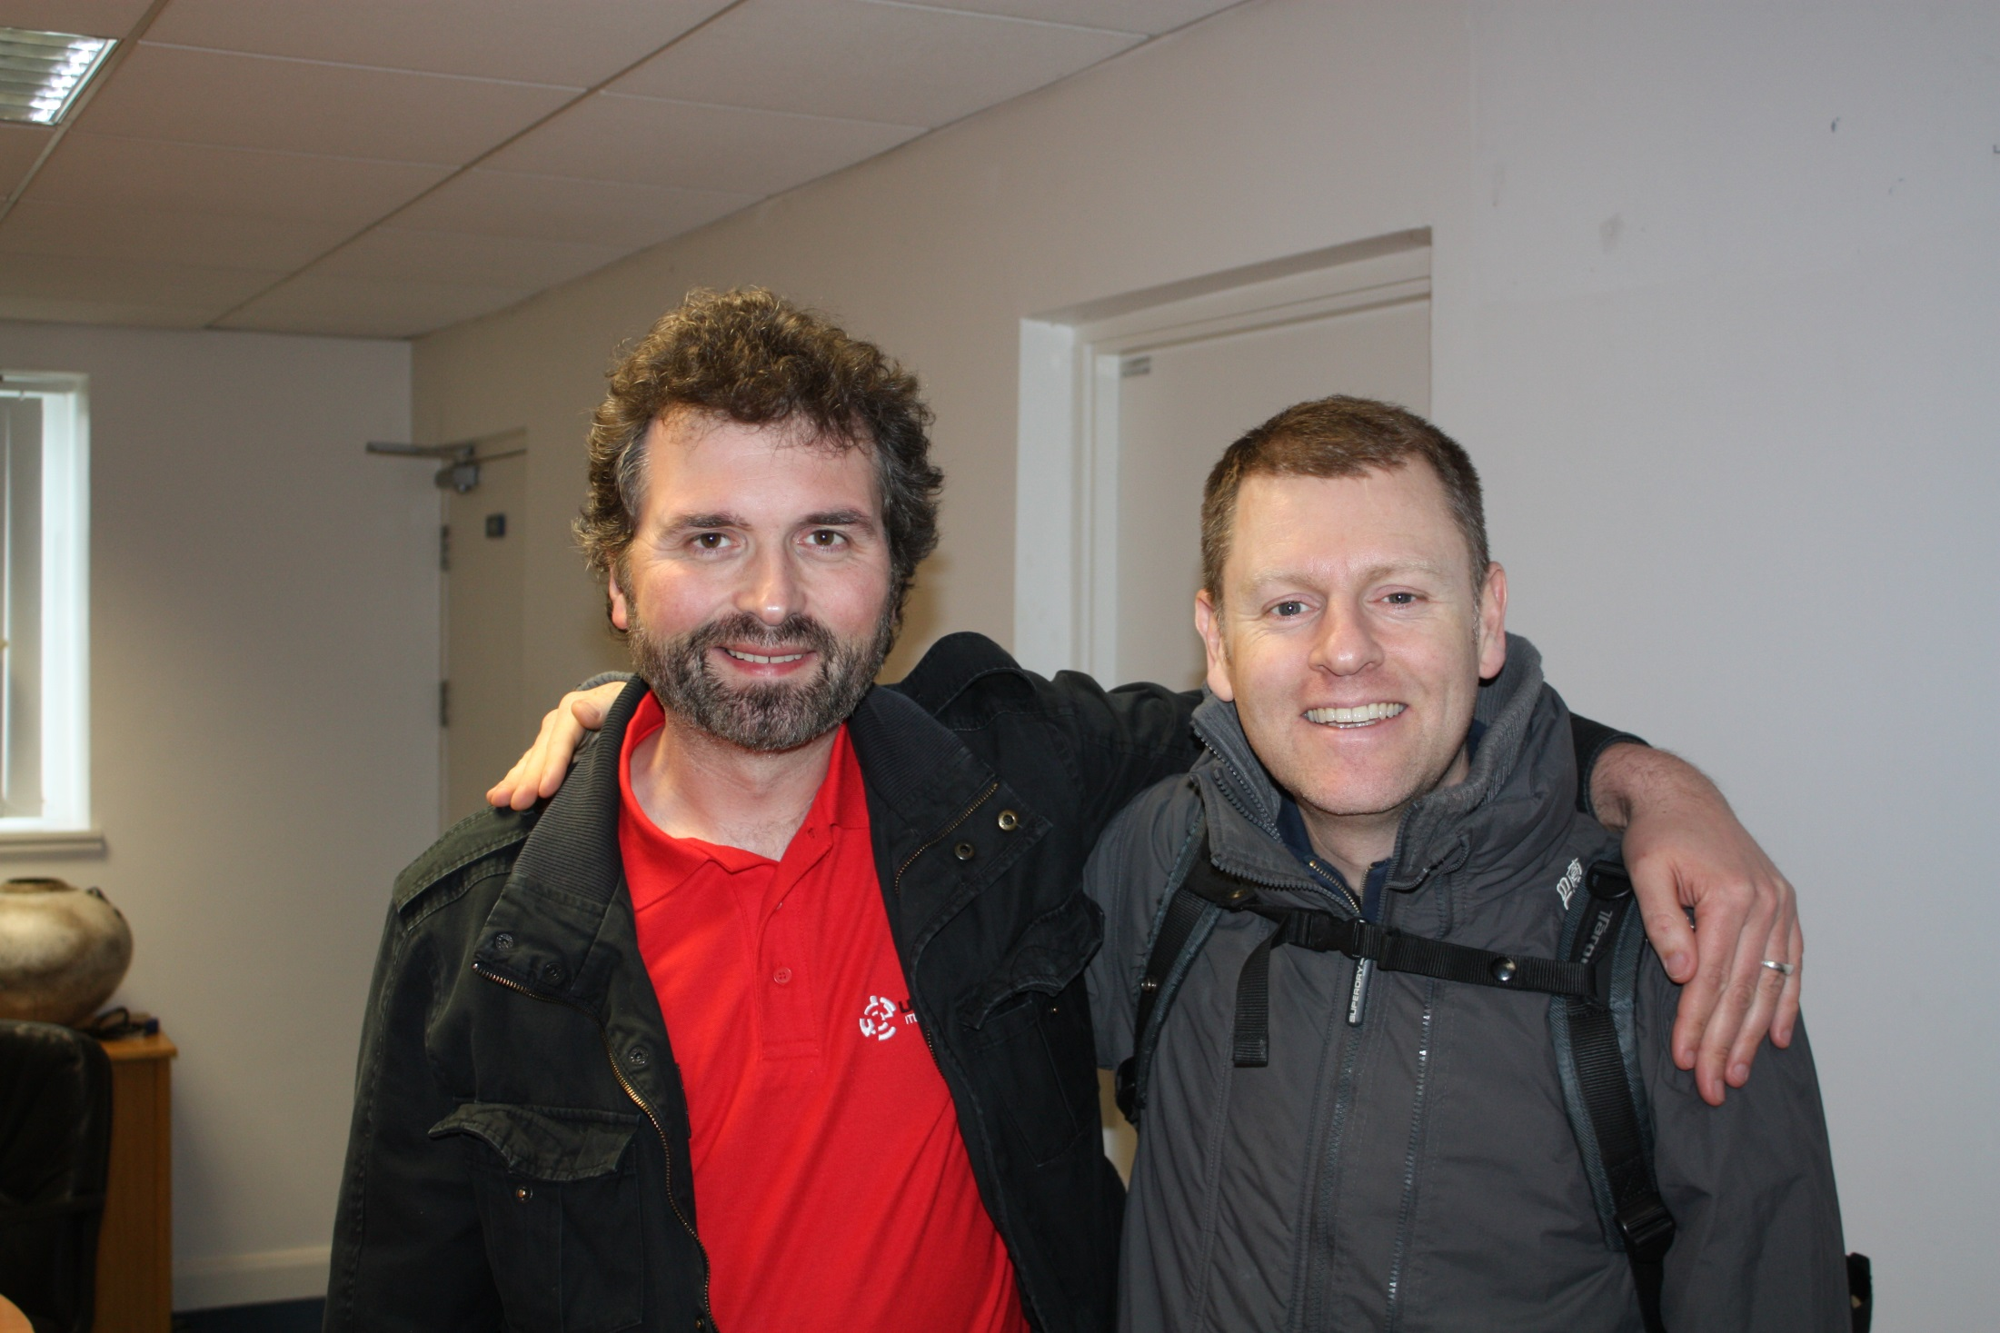

Slide 71



Slide 72

DO THIS NOW!!

Slide 73

Keep in mind.. NO ONE in the history of programming EVER learned to program in one of these…

Slide 74


Consider…

Slide 75
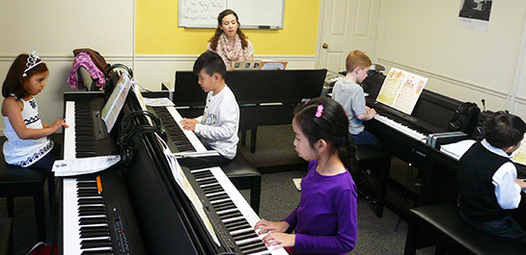

Consider..

Slide 76
